Slide 1

CyVerse Overview
National Academies Special Topics Summer Institute on Quantitative Biology
Jason Williams – Lead, CyVerse – Education, Outreach, Training
Cold Spring Harbor Laboratory
williams@cshl.edu [ @JasonWilliamsNY]

Slide 2
Download Slides and Follow Along
cyverse-qubes.readthedocs.io

Slide 3



CyVerse Evolution
iPlant 2008
Empowering a New Plant Biology
iPlant 2013
Cyberinfrastructure for Life Science
CyVerse 2016
Transforming Science Through Data-Driven Discovery

Slide 4

CyVerse Evolution
We are funded by the National Science Foundation
We are your colleagues and collaborators!
$100 Million in investment
Freely available to the community
Spur national/international collaboration
Cite CyVerse:
CyVerse.org/acknowledge-cite-cyverse
DBI-0735191 and DBI-1265383

Slide 5
CyVerse Evolution
Vision:
Transforming science through data-driven discovery
Mission:
Design, develop, deploy, and expand a national cyberinfrastructure for life science research, and train scientists in its use
More than 30K users, PB of data, and hundreds of publications, courses, and discoveries
CyVerse 2016
Transforming Science Through Data-Driven Discovery

Slide 6
What is Cyberinfrastructure?
Data storage
Software
High-performance computing
People
organized into systems that solve problems of size and scope that would not otherwise be solvable.

Slide 7
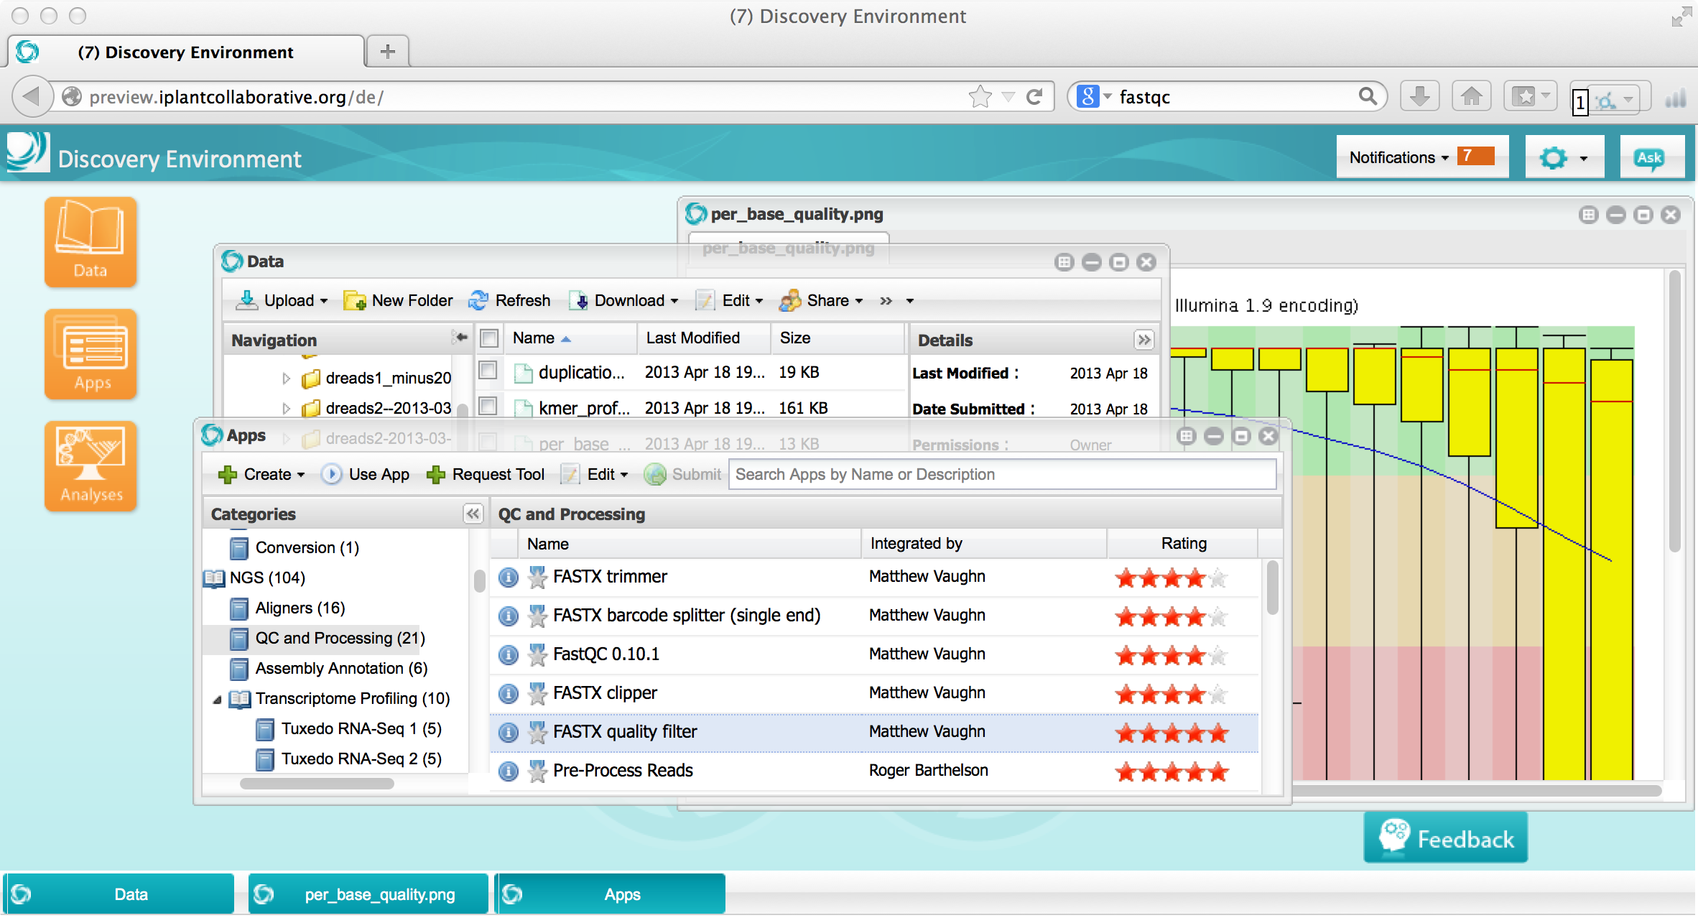
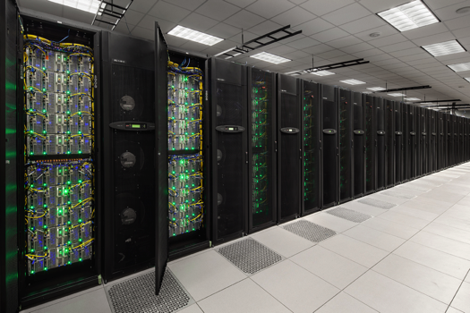
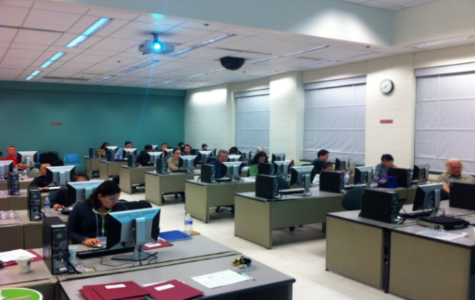
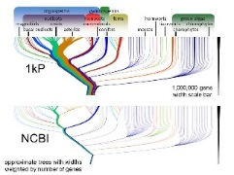
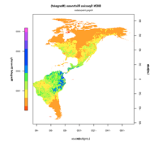
What is Cyberinfrastructure?
Platforms, tools, datasets Storage and compute Training and support

Slide 8
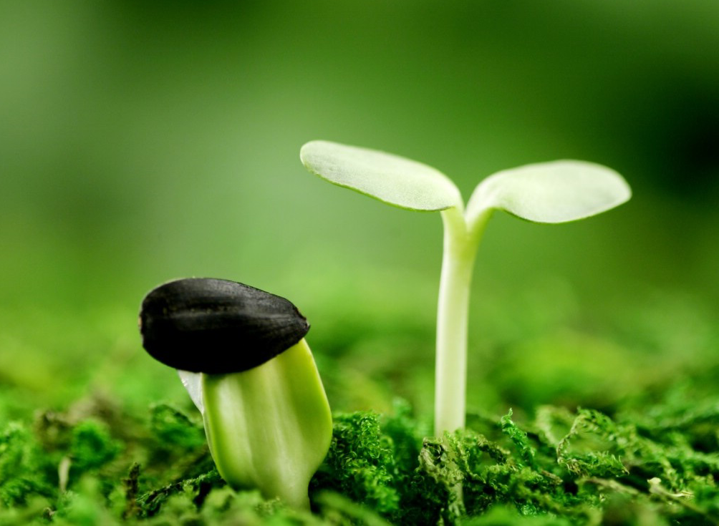
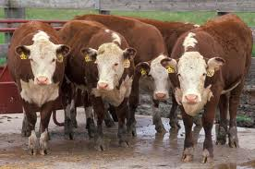


CyVerse supports all domains of life science
Plant / Microbial Animal Biomedical Ecological/Climate
CyVerse is built for Data

Slide 9
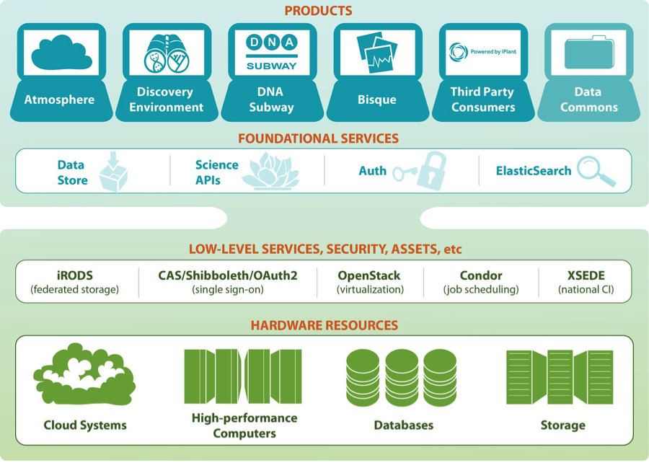
CyVerse product stack
Ready to use Platforms
Extensible Services
Flexibility
Ease of Use
Established CI Components
Foundational Capabilities

Slide 10
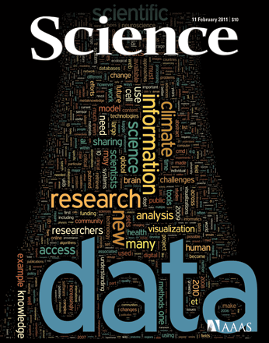
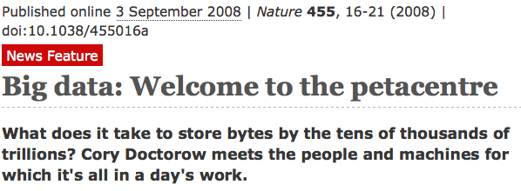
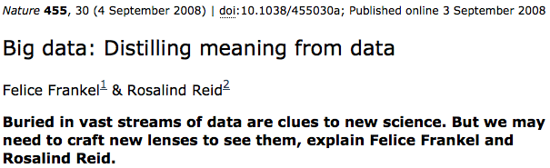
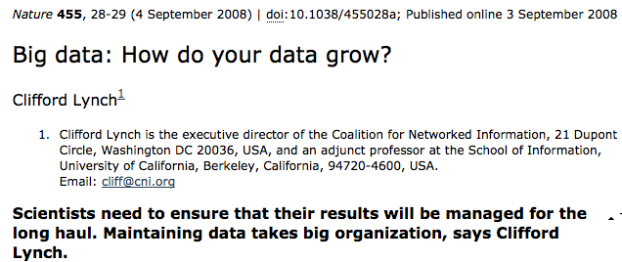
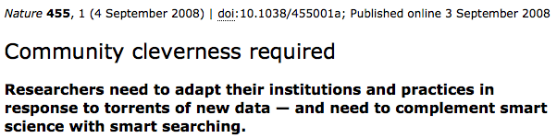
How was CyVerse built?

Slide 11
CyVerse Community Priorities
Genomic data and analysis:
Reference guided assembly
De novo assembly
RNA-Seq (expression; gene/isoform discovery)
Variant calling
Genome/Transcriptome annotation
ChIP-Seq/Integration of epigenetic information
Multiple sequencing platforms
New and evolving technologies

Slide 12
CyVerse Community Priorities
Predictive and synthetic
Pathway
Analysis
Association Studies
Evolutionary Models
Ecological Models
Knowledge gathering
Genomic
data
Environmental data
Phenotype data
Retrodictive insights
Phylogenetic Inferences

Slide 13










CyVerse Institutions
CyVerse is a collaborative virtual organization
CyVerse UK

Slide 14
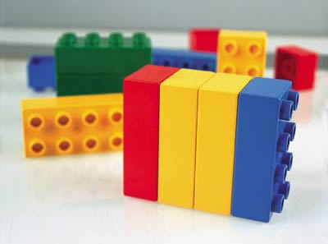
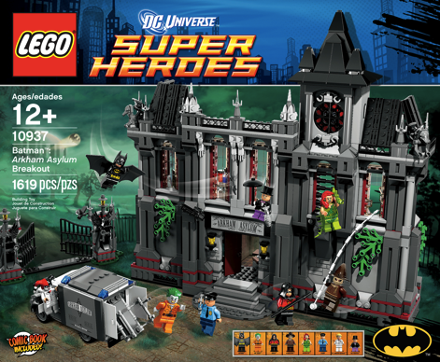
CyVerse Products
We strive to be the CI Lego blocks
Danish 'leg godt' - 'play well’
Also translates as 'I put together' in Latin
If a solution is not available you can craft your own using CyVerse CI components

Slide 15

Data Store
The resources you need to share and manage data with your lab, colleagues and community
Initial 100 GB allocation – TB allocations available
Automatic data backup
Easy upload /download and sharing
Notes:
Focus here is on genomics data, but not restricted to genomics data

Slide 16

Discovery Environment
Hundreds of bioinformatics Apps in an easy-to-use interface
A platform that can run almost any bioinformatics application
Seamlessly integrated with data and high performance computing
User extensible – add your own applications
Notes:
Focus here is on genomics data, but not restricted to genomics data

Slide 17

Atmosphere
Cloud computing for the life sciences
Simple: One-click access to more than 200 virtual machine images
Flexible: Fully customize your software setup
Powerful: Integrated with iPlant computing and data resources
Notes:
Focus here is on genomics data, but not restricted to genomics data

Slide 18

Science APIs
Fully customize iPlant resources
Science-as-a-service platform
Define your own compute, and storage resources (local and iPlant)
Build your own app store of scientific codes and workflows
Notes:
Focus here is on genomics data, but not restricted to genomics data

Slide 19

DNA Subway
Educational workflows for Genomes, DNA Barcoding, RNA-Seq
Commonly used bioinformatics tools in streamlined workflows
Teach important concepts in biology and bioinformatics
Inquiry-based experiments for novel discovery and publication of data
Notes:
Focus here is on genomics data, but not restricted to genomics data

Slide 20

Bisque
Image analysis, management, and metadata
Secure image storage, analysis, and data management
Integrate existing applications or create new ones
Custom visualization and image handling routines and APIs
Notes:
Focus here is on genomics data, but not restricted to genomics data

Slide 21
CyVerse Executive Team

